Slide 1
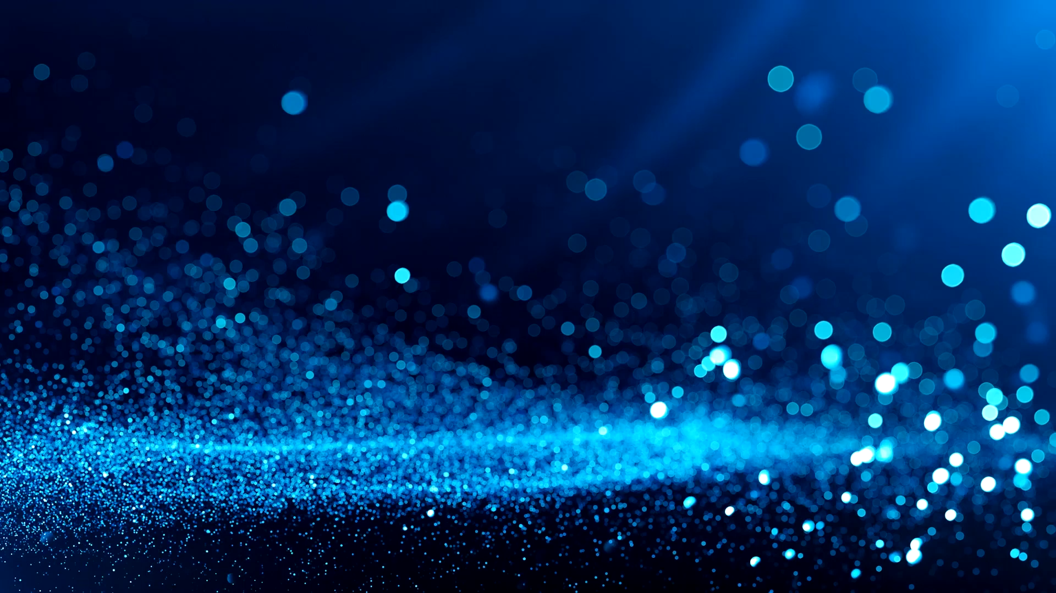
Appreciating Indian Music Using AI
Chetan | Lokesh | Nupur
MS – Software Engineering
Advisor : Dr. Vishnu Pendyala

Slide 2
Introduction
Hindustani classical music is a multi-faceted and ancient form of musical art that has its roots in the Indian subcontinent.
The main key element in Hindustani classical music is called raga (or “raag”).
Many people want to learn to sing Hindustani classical music for personal passion or interest.

Slide 3
Problem Statement
We don’t have enough resources to learn Hindustani classical music because it is very complicated.
Unavailability of Hindustani music Teachers.
Expensive lessons.

Slide 4
Our Solution
Music tutor – Deep learning model to assist the students.
Affordable
High availability
User friendly

Slide 5
Datasets
We decided on creating our own dataset. The dataset collection was done in two parts.
Manually downloading songs from YouTube.
Downloading songs from Dunya using PyCompmusic library

Slide 6
Data Processing
Used Google Colab Pro notebook for preprocessing and feature extraction.
Used librosa library to extract audio features which are understandable to a machine learning algorithm.
Converted each mp3 audio data into 13 Mel-frequency cepstral coefficients (MFCCs) features and stored them into a json file along with their corresponding raga label.
Also, extracted features like spectrogram and chromagram images.

Slide 7
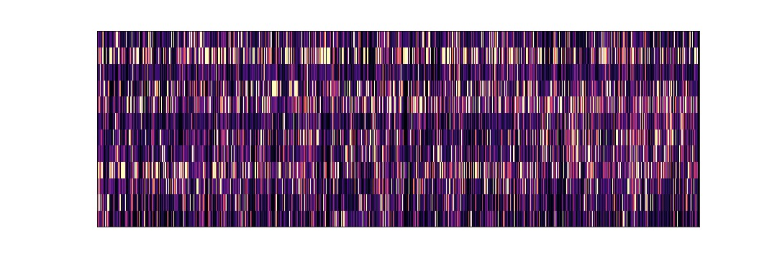
Chromagram approach
The term chroma feature or chromagram closely relates to the twelve different pitch classes. Chroma-based features are a powerful tool for analyzing music whose pitches can be meaningfully categorized.

Slide 8
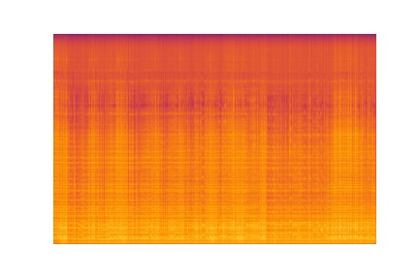
Spectrogram approach
A spectrogram is a visual representation of the spectrum of frequencies of a signal as it varies with time. When applied to an audio signal, spectrograms are sometimes called sonographs, voiceprints, or voicegrams.

Slide 9
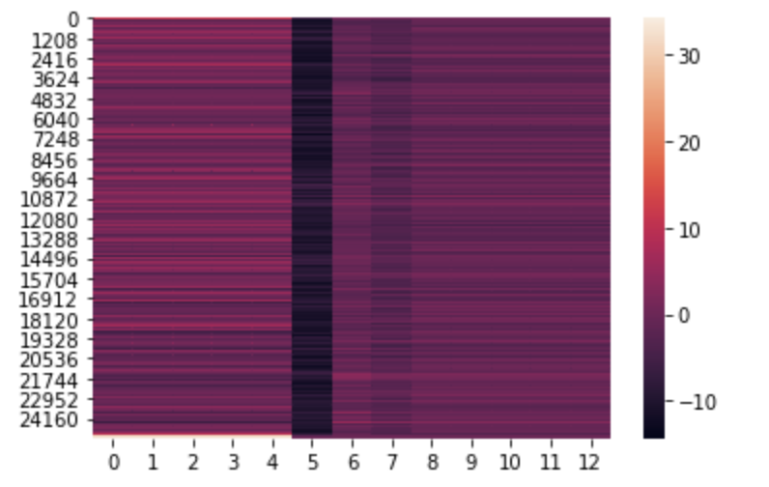
Mel Frequency Cepstrum (MFCC)
The MFCCs are a very powerful representation of an audio signal as it scales the frequency in order to match more closely what the human ear can hear.

Slide 10
Transfer Learning
We trained deep Covolutional Neural Network model and transfer learning on pretrained models on spectrogram and chromagram images extracted from the mp3 audio data.
We thought of using pretrained ResNet model,ImageNet.AlexNet because in image classification tasks pretrained models have yielded better results in some cases.
While training the ResNet model we only trained top layers so that we can use pre trained weights for our advantage.
These techniques yielded very bad result with less than 40% accuracy

Slide 11
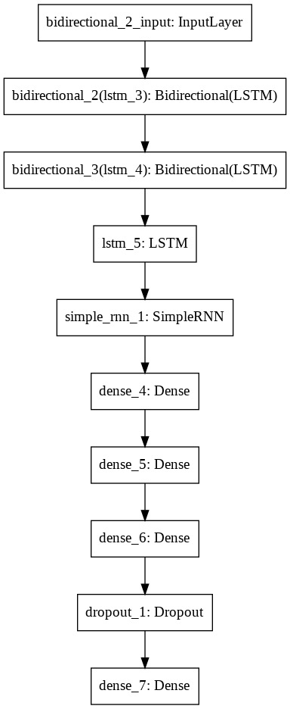
Training
Built deep learning model using LSTM, BiLSTMs and RNNs.
These neural networks are known to deal with sequential data.

Slide 12
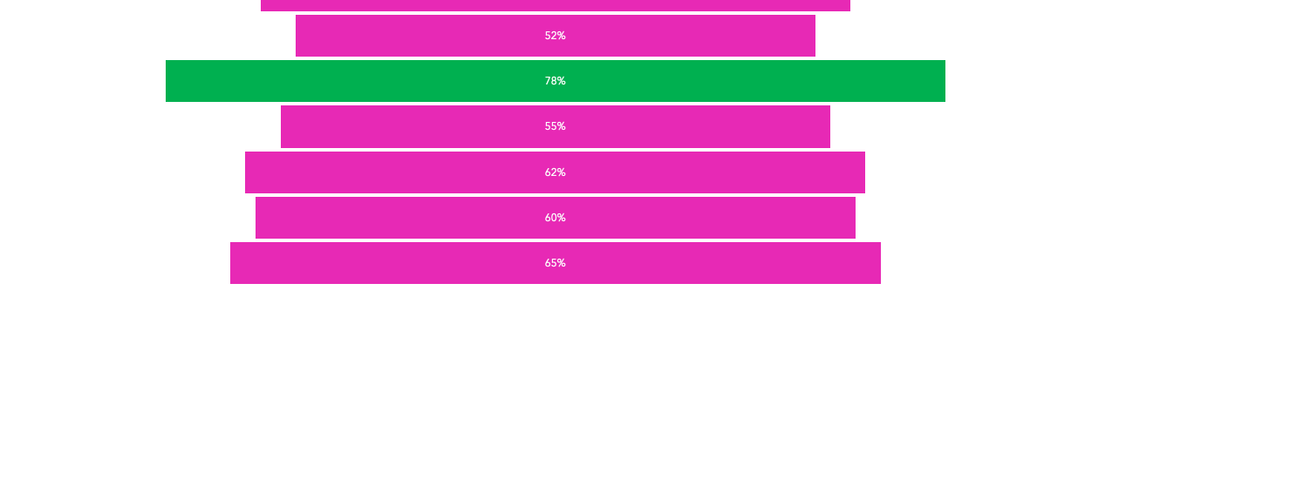
Model Evaluation

Slide 13
Tensorflow Extended
TensorFlow Extended (TFX) is an end-to-end platform for deploying production ML pipelines.
By default, TensorFlow serving provides the rest endpoint for users to get their predictions.

Slide 14
Docker
Docker is a set of platform as a service products that use OS-level virtualization to deliver software in packages called containers.
Docker enables developers to easily pack, ship, and run any application as a lightweight, portable, self-sufficient container, which can run virtually anywhere.
The two main docker containers in this project are
1 ) Django web application Container.
2 ) Raga Prediction Model Container.

Slide 15
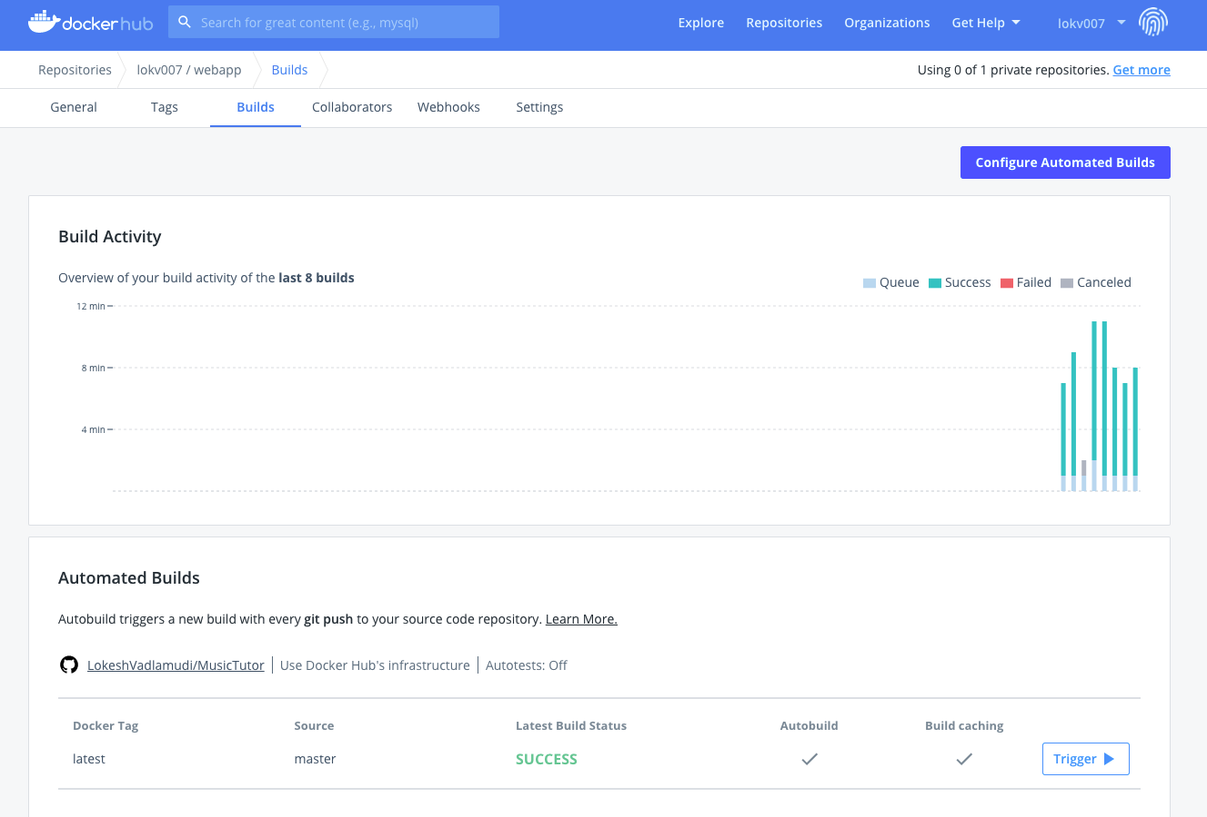
Continuous Integration (CI)
When we commit to a master branch on Github, the Dockerhub pulls the code into its workspace and starts building a new image automatically.

Slide 16
Kubernetes
Kubernetes is an open-source container orchestration platform that enables the operation of an elastic web server framework for cloud applications. It offers portability, and faster, simpler deployment times.
We have deployed both the web application as well as machine learning model on the cluster.
We have three identical pods in total, and load is distributed between the three with the help of a load balancer service.

Slide 17
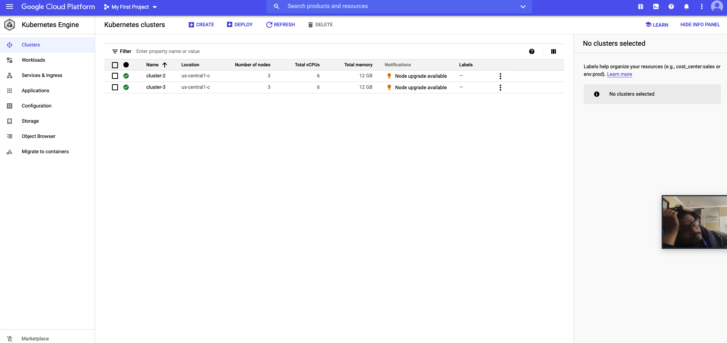
List of Clusters

Slide 18
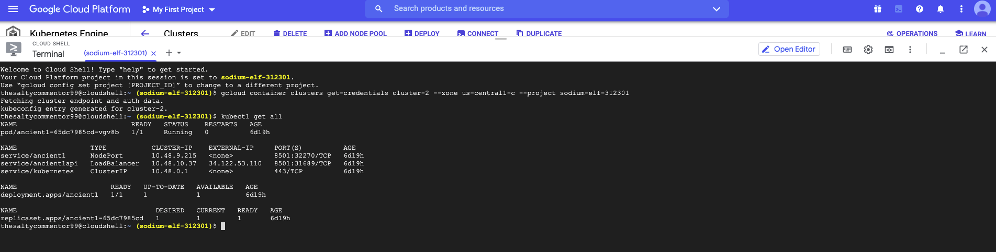
GCP Console

Slide 19
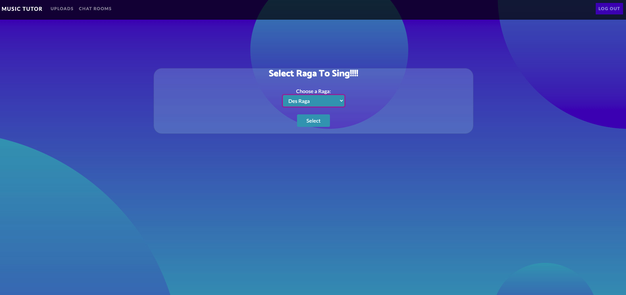
Web Application - Django

Slide 20
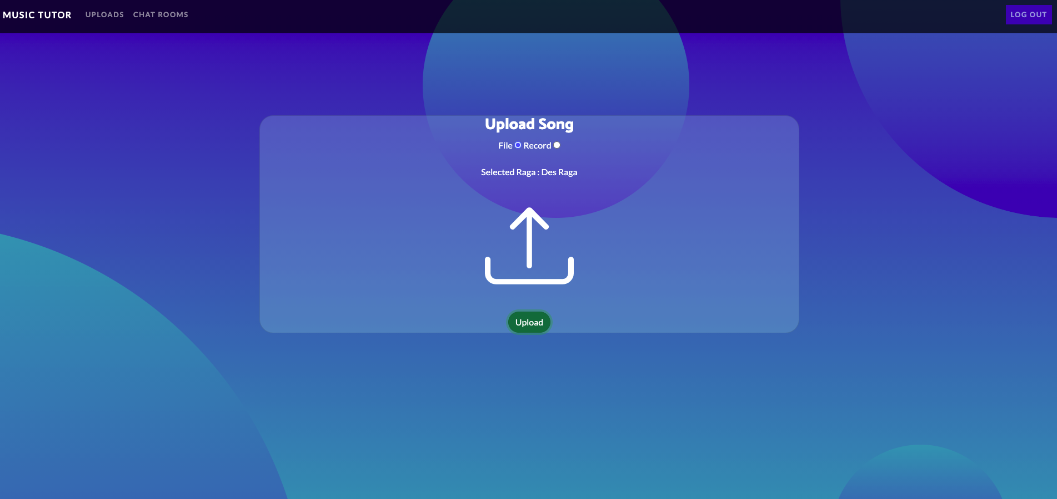
Upload Screen

Slide 21
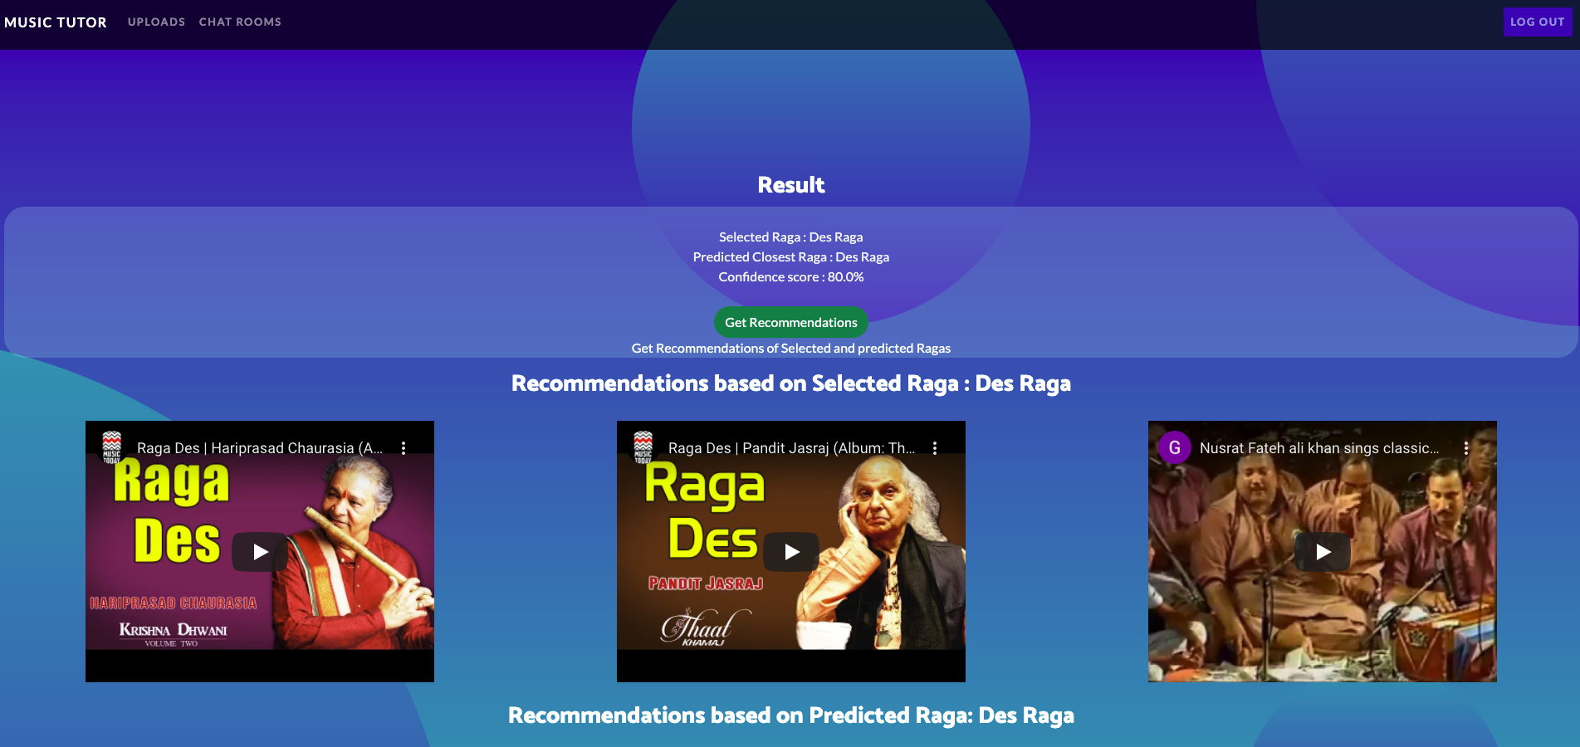
Result Screen

Slide 22
Conclusion
Through various experiments and validations, we found that the best deep learning solution uses 3 LSTM layers (2 BiLSTM and 1 LSTM) followed by a simple RNN layer which is further followed by 3 dense layers.
The system was able to distinguish between five ragas with an accuracy of 78%. The system is adaptable and can be used for other AIR tasks as well.
The HCM dataset we had was very limited, so maybe we can gather more data in future to achieve better results.

Slide 23

Thank You

